Slide 1
Lab 2
ITEC618 Labs
Programming Concepts
Dr. Farshid Keivanian

Slide 2
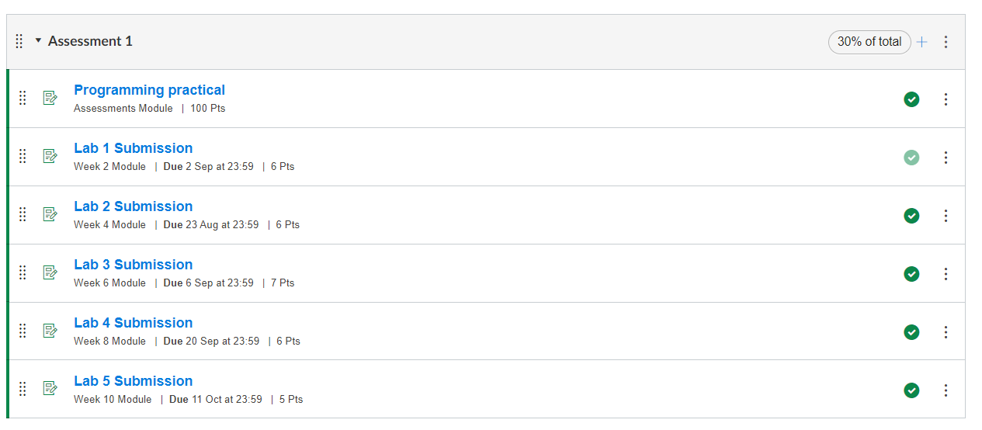

Slide 3
Task completion (3%)
4.1 (0.5%) Write a java program to display 19/3 as whole number quotient and numerator and denominator in a mixed fraction. For instance, the fixed fraction form of 19/3 is 6 1/3.
Given the inputs of 19 and 3 to be stored in two variables, your program must display:
Whole number quotient is: 6
The numerator of the mixed fraction is: 1
Hint: You can use the % operator to find the numerator in the mixed fraction and / operator to find the whole number quotient.

Slide 4
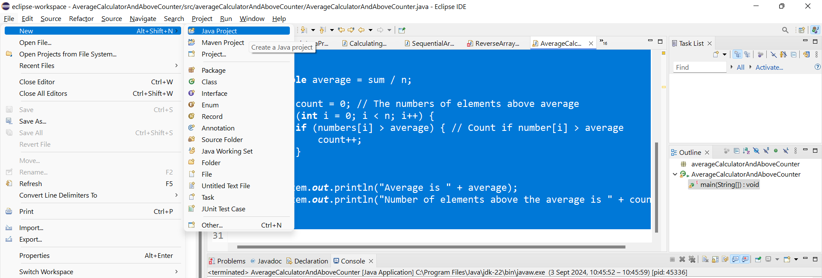
Task completion (3%)

Slide 5
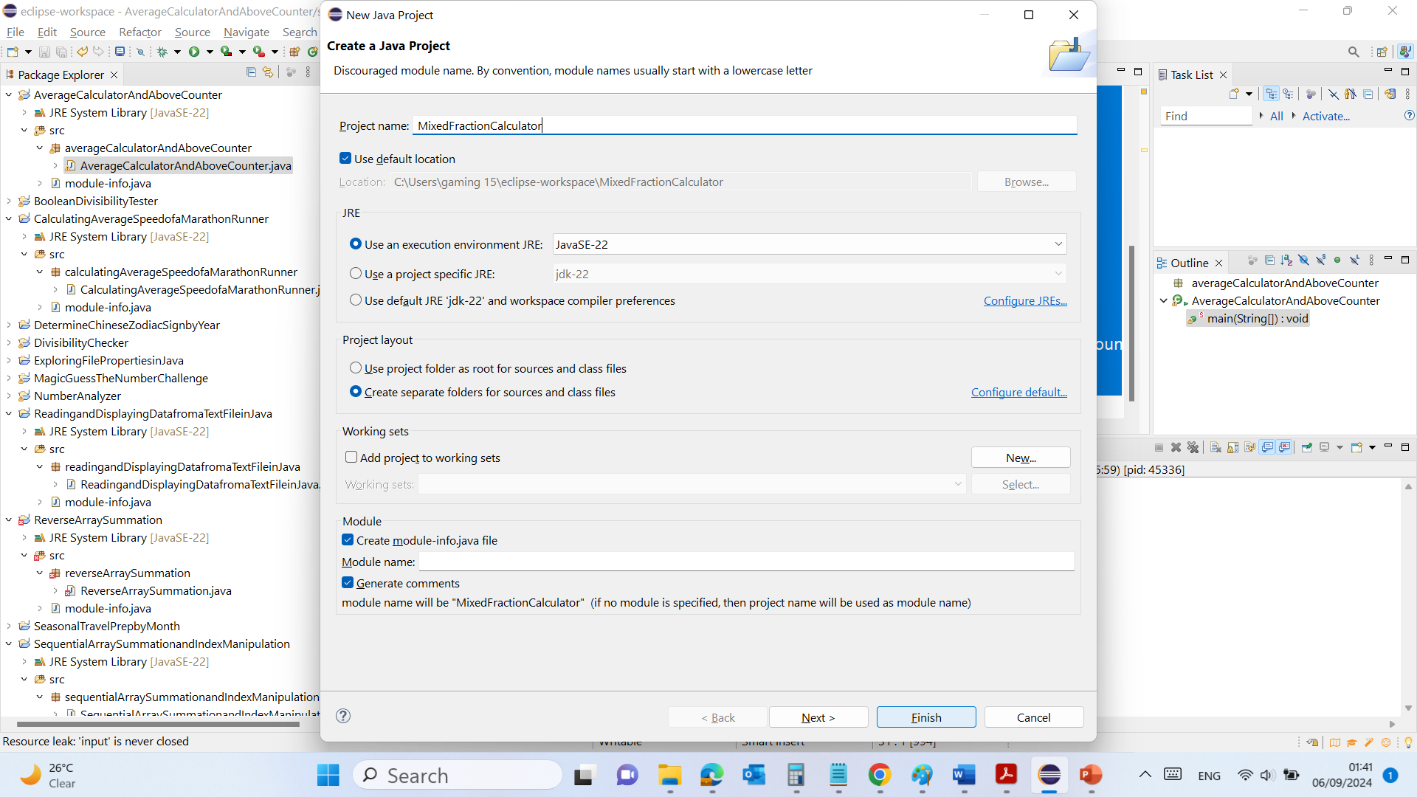
Task completion (3%)

Slide 6
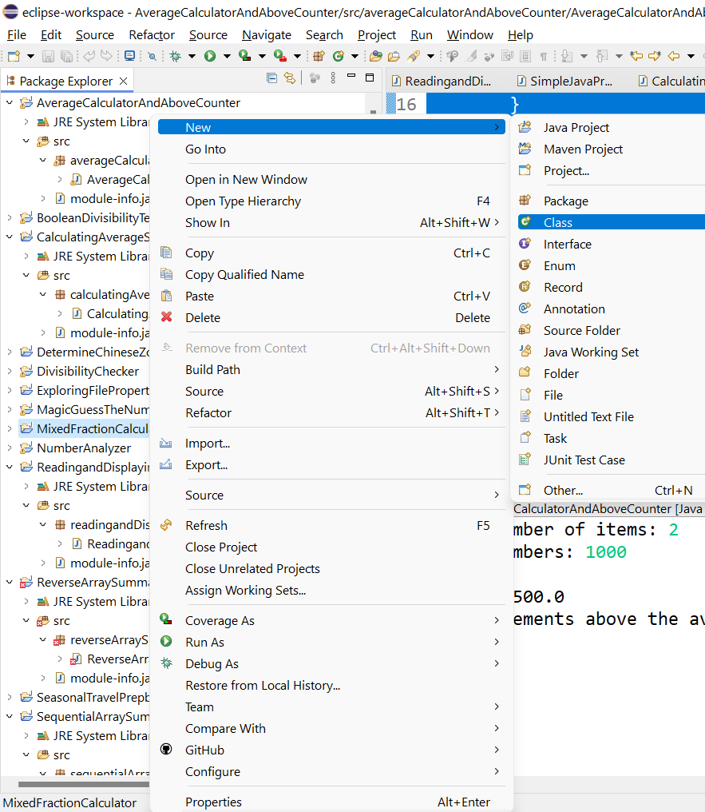
Task completion (3%)

Slide 7
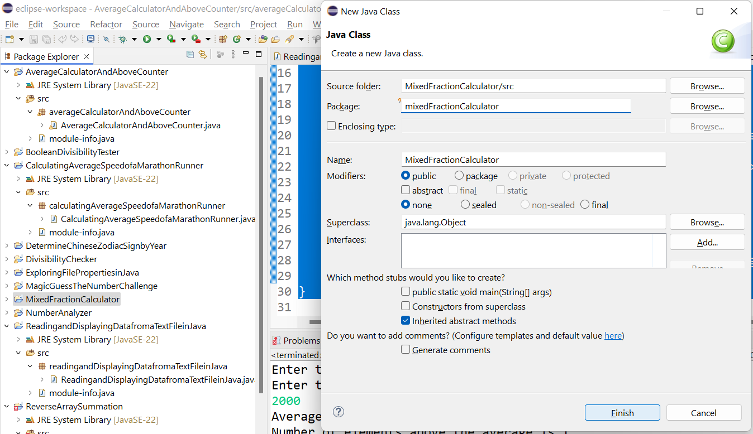
Task completion (3%)

Slide 8
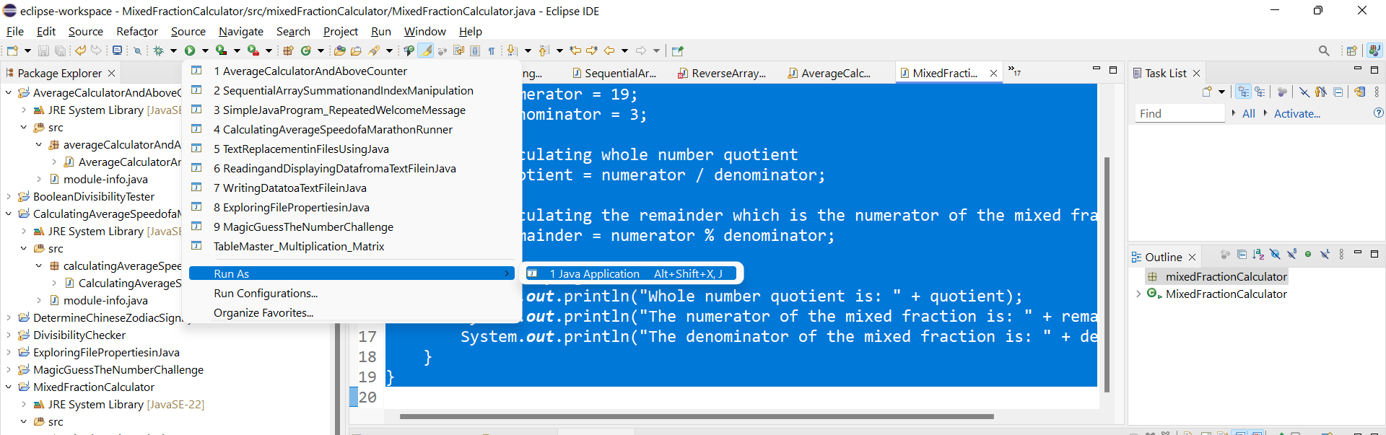
Task completion (3%)

Slide 9
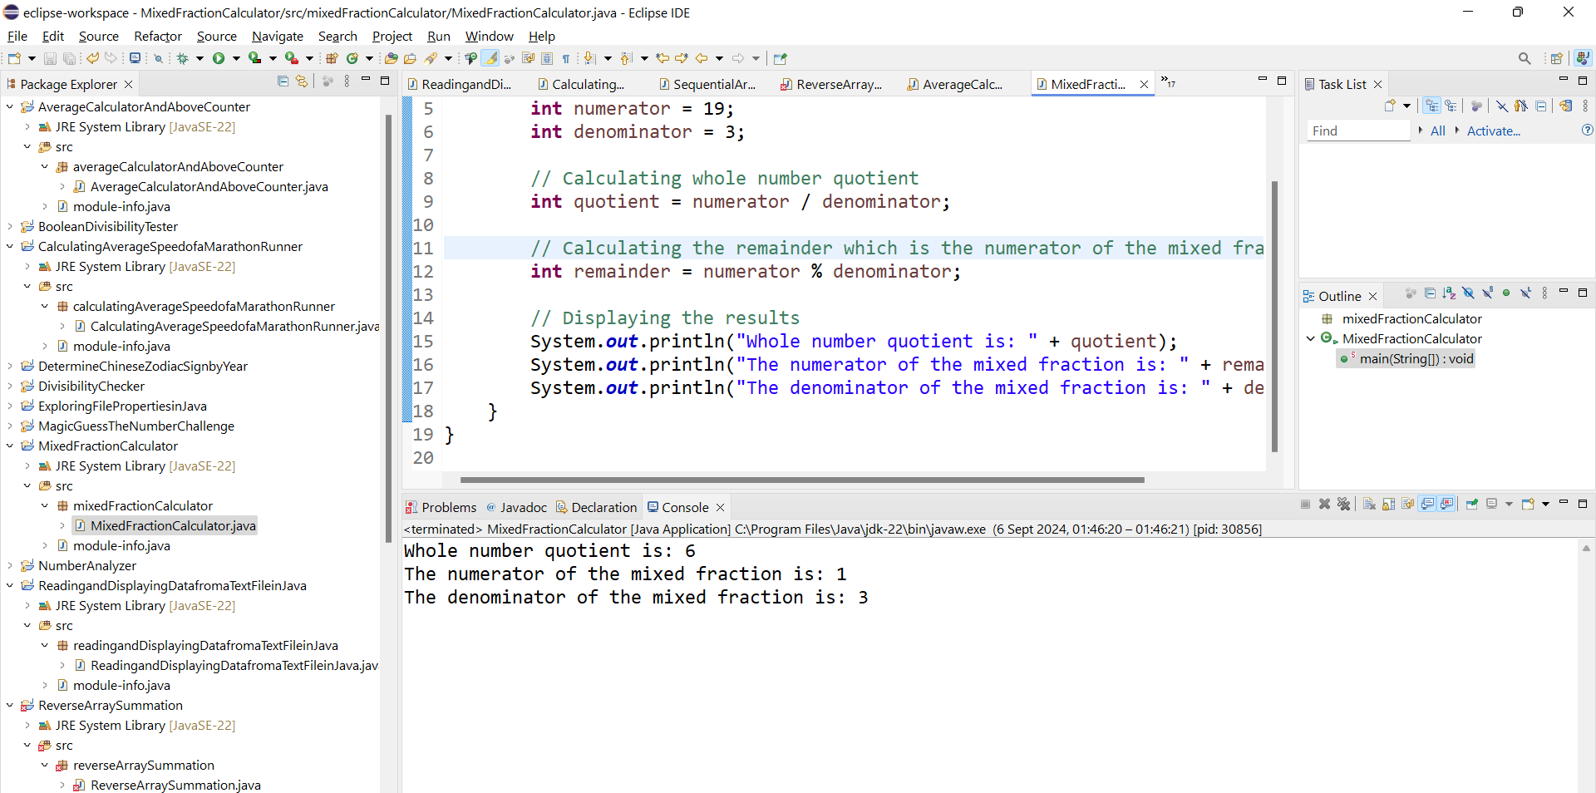


Task completion (3%)
$$6\frac{1}{3}$$

Slide 10
Please Explain Each Part of the Code
package mixedFractionCalculator;
public class MixedFractionCalculator {
public static void main(String[] args) {
int numerator = 19;
int denominator = 3;
// Calculating whole number quotient
int quotient = numerator / denominator;
// Calculating the remainder which is the numerator of the mixed fraction
int remainder = numerator % denominator;
// Displaying the results
System.out.println("Whole number quotient is: " + quotient);
System.out.println("The numerator of the mixed fraction is: " + remainder);
System.out.println("The denominator of the mixed fraction is: " + denominator);
}
}

Slide 11
Please Explain Each Part of the Code
package mixedFractionCalculator;
public class MixedFractionCalculator {
public static void main(String[] args) {
int numerator = 19;
int denominator = 3;
// Calculating whole number quotient
int quotient = numerator / denominator;
// Calculating the remainder which is the numerator of the mixed fraction
int remainder = numerator % denominator;
// Displaying the results
System.out.println("Whole number quotient is: " + quotient);
System.out.println("The numerator of the mixed fraction is: " + remainder);
System.out.println("The denominator of the mixed fraction is: " + denominator);
}
}
Modify the program to use different values for the numerator and denominator (e.g., 25/4). Run and Show the Results

Slide 12
Modify the program to handle cases where the denominator is zero, printing an error message instead of performing the division. Run and Show the Results
package mixedFractionCalculator;
public class MixedFractionCalculator {
public static void main(String[] args) {
int numerator = 19;
int denominator = 3;
// Calculating whole number quotient
int quotient = numerator / denominator;
// Calculating the remainder which is the numerator of the mixed fraction
int remainder = numerator % denominator;
// Displaying the results
System.out.println("Whole number quotient is: " + quotient);
System.out.println("The numerator of the mixed fraction is: " + remainder);
System.out.println("The denominator of the mixed fraction is: " + denominator);
}
}

Slide 13
Task completion (3%)
4.2 (0.5%) (Total Invoice) Write a practical Java program that reads the subtotal and the gratuity rate from keyboard using Scanner and then computes the gratuity and total. For example, if the user enters 10 for subtotal and 12 for gratuity rate, the program displays $1.2 as gratuity and $11.2 as total.
Here is a sample run:
Enter the subtotal and a gratuity rate: 10 12
The gratuity is $1.2 and the total is $11.2

Slide 14
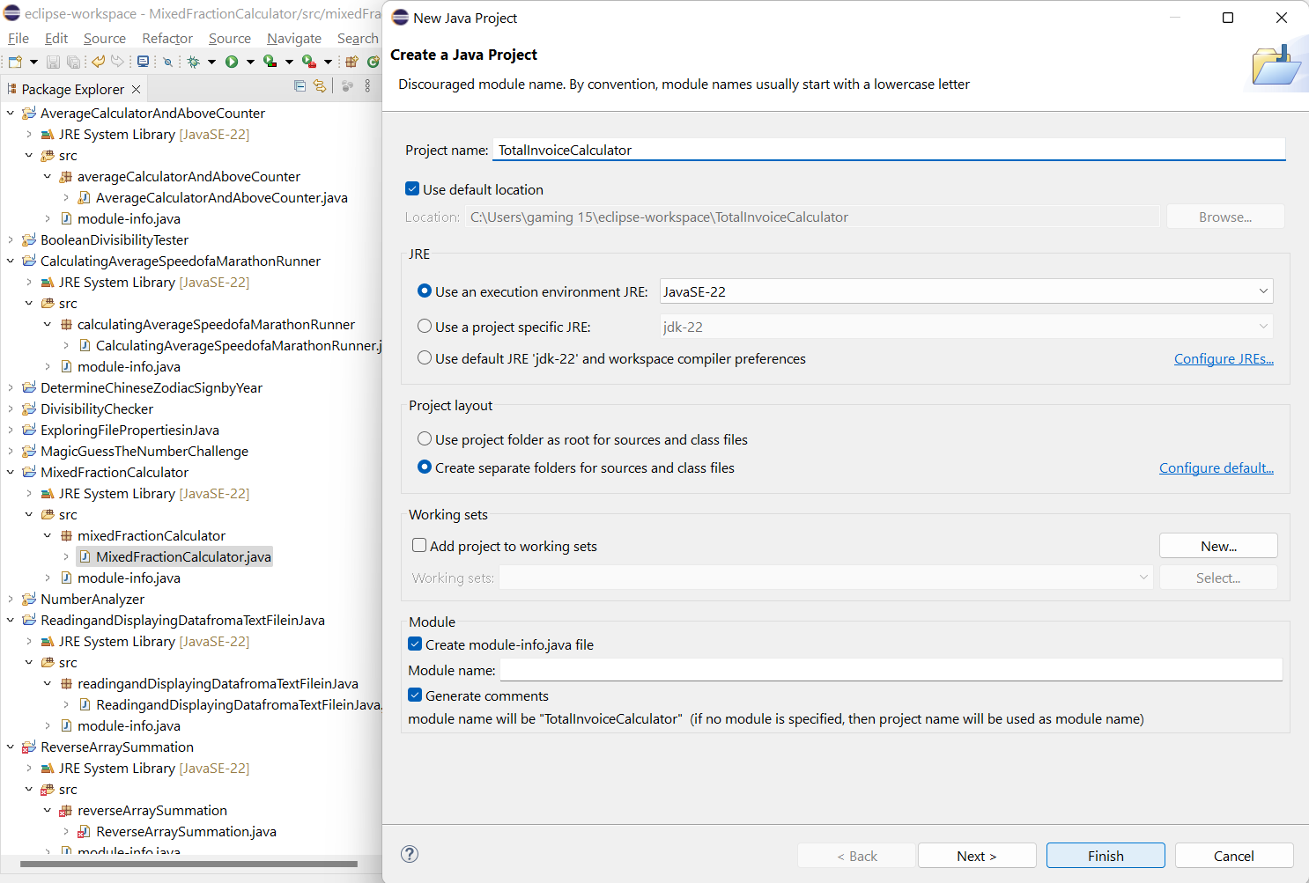
Task completion (3%)

Slide 15
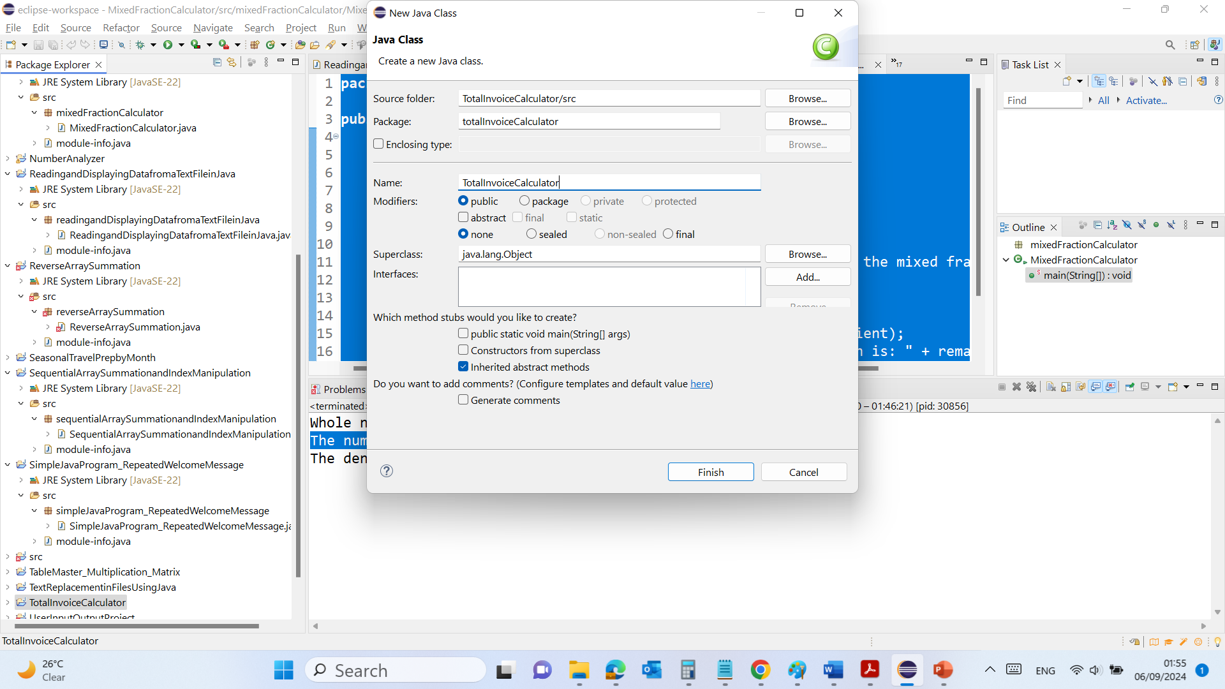
Task completion (3%)

Slide 16

Task completion (3%)

Slide 17
Task completion (3%)
package totalInvoiceCalculator;
This line declares that the class TotalInvoiceCalculator belongs to the package totalInvoiceCalculator. Packages are used to group related classes and help organize the project.

Slide 18
Task completion (3%)
import java.util.Scanner;
This line imports the Scanner class from the java.util package. The Scanner class is used to read input from various input sources, in this case, the keyboard.

Slide 19
Task completion (3%)
public class TotalInvoiceCalculator {
This line declares a public class named TotalInvoiceCalculator. The class is the blueprint for creating objects, but in this case, it's simply used to contain the main method which will run the program.

Slide 20
Task completion (3%)
public static void main(String[] args) {
This line declares the main method, which is the entry point of any Java application. The main method is where the program starts executing.

Slide 21
Task completion (3%)
Scanner scanner = new Scanner(System.in);
This line creates a Scanner object named scanner that is used to read input from the keyboard (System.in).

Slide 22
// Reading the subtotal and gratuity rate from the keyboard
System.out.print("Enter the subtotal and a gratuity rate: ");
double subtotal = scanner.nextDouble();
double gratuityRate = scanner.nextDouble();
The System.out.print statement displays a prompt asking the user to enter the subtotal and gratuity rate.
scanner.nextDouble() reads the next double value entered by the user from the keyboard and stores it in the subtotal variable.
The second scanner.nextDouble() reads the next double value entered by the user and stores it in the gratuityRate variable.

Slide 23
// Calculating the gratuity
double gratuity = subtotal * (gratuityRate / 100);
This line calculates the gratuity amount by multiplying the subtotal by the gratuity rate (which is converted to a percentage by dividing by 100). The result is stored in the gratuity variable.

Slide 24
// Calculating the total
double total = subtotal + gratuity;
This line calculates the total amount by adding the gratuity to the subtotal. The result is stored in the total variable.

Slide 25
// Displaying the results
System.out.println("The gratuity is $" + gratuity + " and the total is $" + total);
This line prints out the calculated gratuity and total to the console. It concatenates the strings with the calculated gratuity and total values to create a readable output.

Slide 26
// Closing the scanner
scanner.close();
This line closes the scanner object to prevent resource leaks. It's good practice to close scanners when they are no longer needed.

Slide 27
Task completion (3%)
package totalInvoiceCalculator;
import java.util.Scanner;
public class TotalInvoiceCalculator {
public static void main(String[] args) {
Scanner scanner = new Scanner(System.in);
// Reading the subtotal and gratuity rate from the keyboard
System.out.print("Enter the subtotal and a gratuity rate: ");
double subtotal = scanner.nextDouble();
double gratuityRate = scanner.nextDouble();
// Calculating the gratuity
double gratuity = subtotal * (gratuityRate / 100);
// Calculating the total
double total = subtotal + gratuity;
// Displaying the results
System.out.println("The gratuity is $" + gratuity + " and the total is $" + total);
// Closing the scanner
scanner.close();
}
}

Slide 28
Task completion (3%)
Summary:
The program prompts the user to enter a subtotal and gratuity rate.
It then calculates the gratuity by multiplying the subtotal by the gratuity rate (expressed as a percentage).
The program calculates the total by adding the gratuity to the subtotal.
Finally, it displays both the gratuity and the total to the user.

Slide 29
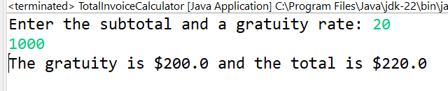
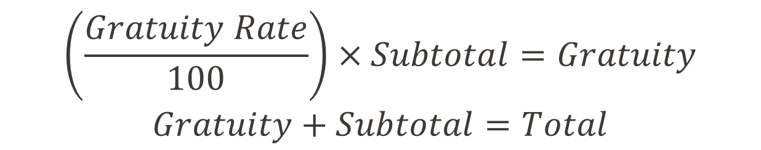
Task completion (3%)
$$\left(\frac{Gratuity Rate}{100}\right)×Subtotal=Gratuity$$
$$Gratuity+Subtotal=Total$$

Slide 30
Task completion (3%)
4.3 (0.5%) Basic Debugging exercises:
The intention of the following program is to sum 10 and 20 to display 30. However, it has a semantic error. Rewrite the program so that it displays the correct answer.
public class Tester{
public static void main (String [ ] a){
System.out.println(The sum of 10" and 20 is " + "10" + "20");
}
}
Given the following program, rewrite the program to fix the syntax errors and write a Java comment before the first line of the program to specify what the errors were.
public class Tester{
public static void main (string [ ] a){
System.out.println(hello students);
}
}

Slide 31
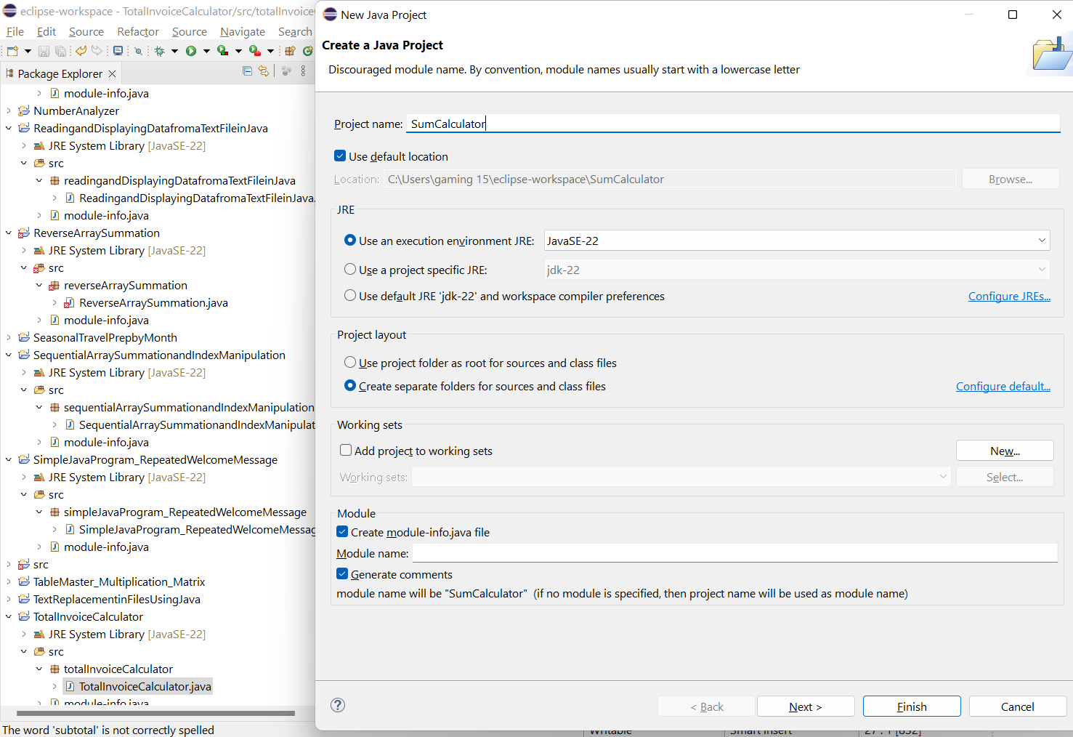
Task completion (3%)

Slide 32
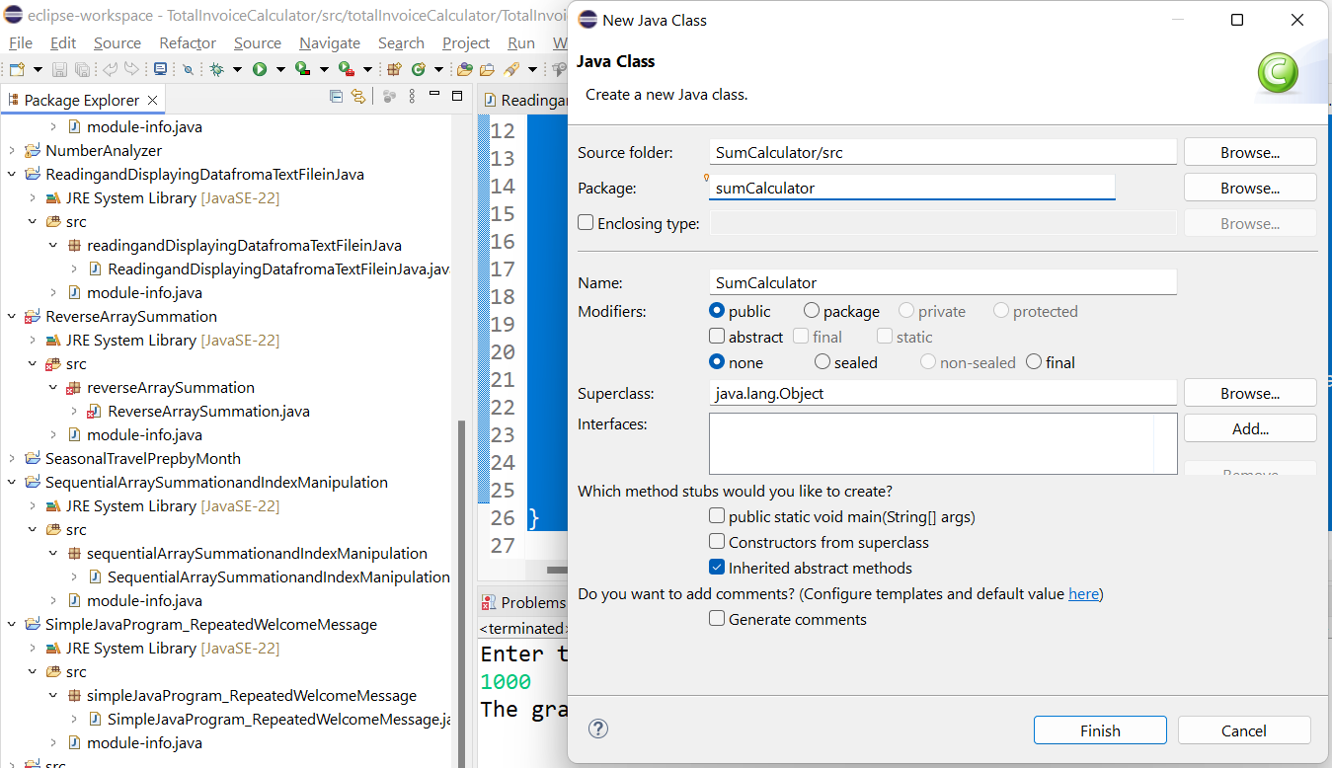
Task completion (3%)

Slide 33
Original Problem:
public class Tester {
public static void main(String[] a) {
System.out.println(The sum of 10" and 20 is " + "10" + "20");
}
}
Problem:
The original program mistakenly concatenates the strings "10" and "20", resulting in the output "1020" instead of performing the arithmetic sum.

Slide 34
Fixed Problem:
public class SumCalculator {
public static void main(String[] args) {
// The error was concatenating strings instead of performing arithmetic addition
System.out.println("The sum of 10 and 20 is " + (10 + 20));
}
}
Explanation:
The error was that the program was concatenating the strings "10" and "20", instead of summing the numbers 10 and 20.
The fix involves using the arithmetic sum (10 + 20) to correctly compute and display the result.

Slide 35
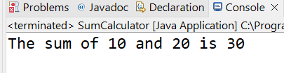
package sumCalculator;
public class SumCalculator {
public static void main(String[] args) {
// The error was concatenating strings instead of performing arithmetic addition
System.out.println("The sum of 10 and 20 is " + (10 + 20));
}
}
This code is now placed within the sumCalculator package

Slide 36
Part 2: Fixing the Syntax Error: Original Program:
public class Tester {
public static void main (string [] a) {
System.out.println(hello students);
}
}
Problem:
The data type string should be capitalized to String.
The System.out.println statement should have the text "hello students" inside quotation marks.
The array brackets should be placed immediately after String, like String[].

Slide 37
Fixed Program:
//Errors fixed: capitalized "string" to "String", added quotes around "hello students"
public class Tester {
public static void main(String[] args) {
System.out.println("hello students");
}
}
Explanation:
Capitalization: The string type was corrected to String, which is the correct data type in Java.
Quotations: The text inside System.out.println now has proper quotation marks around it.
Array Brackets: The array brackets are correctly positioned after String[].

Slide 38
Place the Code Within the Package, Run and Show the Results
//Errors fixed: capitalized "string" to "String", added quotes around "hello students"
public class Tester {
public static void main(String[] args) {
System.out.println("hello students");
}
}

Slide 39
Task completion (3%)
4.4 (0.5%) (Basic Program Selections Exercise) Write a program that prompts the user to enter an integer and determines whether it is divisible by 3 and 5, whether it is divisible by 3 or 5, and whether it is divisible by 3 or 5, but not both. In addition, as the output shows below, your program should abort and print out an error message if the integer entered is not an even number.
Here are sample runs of this program:
Enter an even integer: 30
Is 30 divisible by 3 and 5? true
Is 30 divisible by 3 or 5? true
Is 30 divisible by 3 or 5, but not both? False
Enter an even integer: 15
Input is not an even number. Please try again.

Slide 40
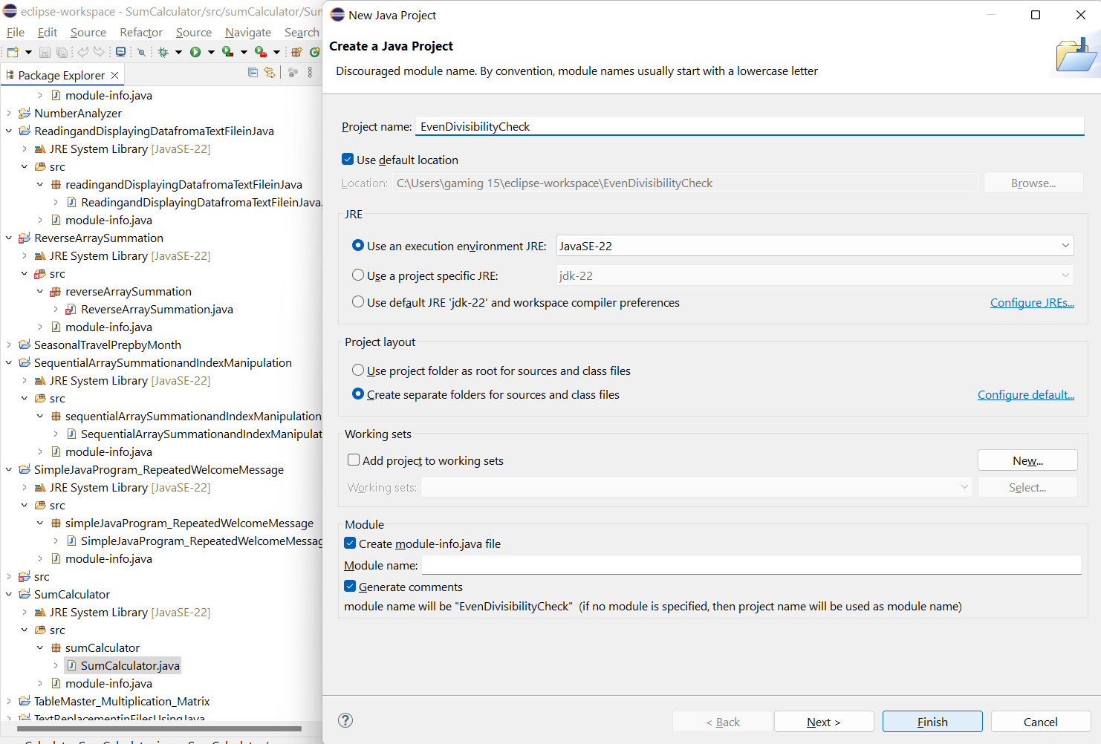
Task completion (3%)

Slide 41
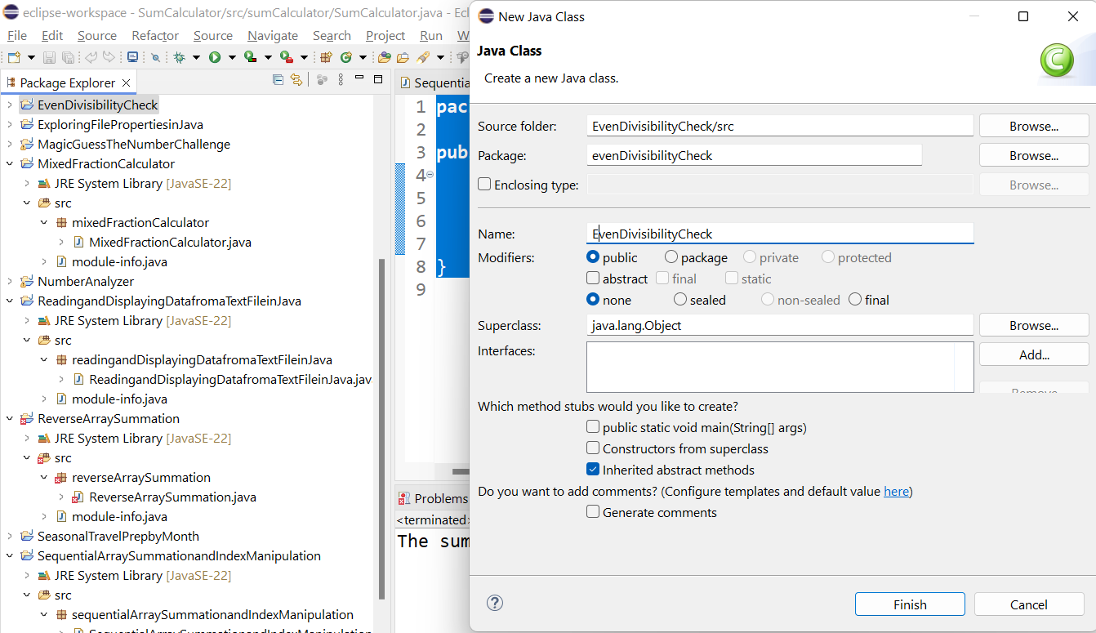
Task completion (3%)

Slide 42
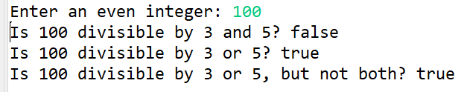
package evenDivisibilityCheck;
import java.util.Scanner;
public class EvenDivisibilityCheck {
public static void main(String[] args) {
Scanner scanner = new Scanner(System.in);
// Prompt the user to enter an even integer
System.out.print("Enter an even integer: ");
int number = scanner.nextInt();
// Check if the number is even
if (number % 2 != 0) {
System.out.println("Input is not an even number. Please try again.");
} else {
// Check if the number is divisible by 3 and 5
boolean divisibleBy3And5 = (number % 3 == 0) && (number % 5 == 0);
// Check if the number is divisible by 3 or 5
boolean divisibleBy3Or5 = (number % 3 == 0) || (number % 5 == 0);
// Check if the number is divisible by 3 or 5, but not both
boolean divisibleBy3Or5ButNotBoth = divisibleBy3Or5 && !(divisibleBy3And5);
// Display the results
System.out.println("Is " + number + " divisible by 3 and 5? " + divisibleBy3And5);
System.out.println("Is " + number + " divisible by 3 or 5? " + divisibleBy3Or5);
System.out.println("Is " + number + " divisible by 3 or 5, but not both? " + divisibleBy3Or5ButNotBoth);
}
// Closing the scanner
scanner.close();
}
}

Slide 43
package evenDivisibilityCheck;
import java.util.Scanner;
public class EvenDivisibilityCheck {
public static void main(String[] args) {
Scanner scanner = new Scanner(System.in);
// Prompt the user to enter an even integer
System.out.print("Enter an even integer: ");
int number = scanner.nextInt();
// Check if the number is even
if (number % 2 != 0) {
System.out.println("Input is not an even number. Please try again.");
} else {
// Check if the number is divisible by 3 and 5
boolean divisibleBy3And5 = (number % 3 == 0) && (number % 5 == 0);
// Check if the number is divisible by 3 or 5
boolean divisibleBy3Or5 = (number % 3 == 0) || (number % 5 == 0);
// Check if the number is divisible by 3 or 5, but not both
boolean divisibleBy3Or5ButNotBoth = divisibleBy3Or5 && !(divisibleBy3And5);
// Display the results
System.out.println("Is " + number + " divisible by 3 and 5? " + divisibleBy3And5);
System.out.println("Is " + number + " divisible by 3 or 5? " + divisibleBy3Or5);
System.out.println("Is " + number + " divisible by 3 or 5, but not both? " + divisibleBy3Or5ButNotBoth);
}
// Closing the scanner
scanner.close();
}
}
Please modify the existing program so that it checks whether the entered even integer is divisible by 2 and 5 instead of 3 and 5.

Slide 44
Task completion (3%)
4.5 (1%) (Basic Program Loops Exercise) Write a java program that uses a while loop to output the average of a number sequence from 0, 2, 4, 6, …, 100, with a step/increment size of 2. Then re-write the program with a for loop.
Hint: to get the average, you should get the sum of the number sequence first and then divide by the total number (count)of numbers (num) in the sequence. Hence, your loop should maintain 3 variables which are num, sum, and count.

Slide 45
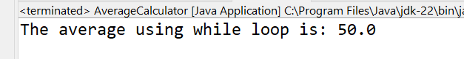
Task completion (3%)
package averageCalculator;
public class AverageCalculator {
public static void main(String[] args) {
int num = 0;
int sum = 0;
int count = 0;
// While loop to calculate the sum and count the numbers
while (num <= 100) {
sum += num;
count++;
num += 2;
}
// Calculating the average
double average = (double) sum / count;
// Displaying the result
System.out.println("The average using while loop is: " + average);
}
}

Slide 46
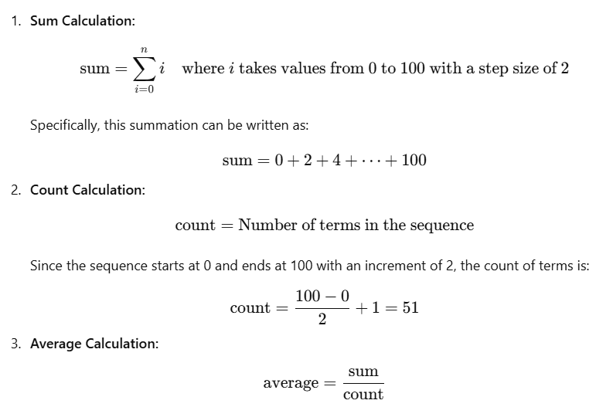

Slide 47
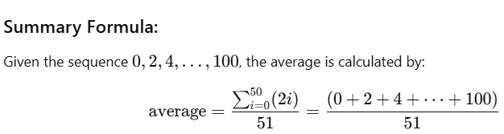

Slide 48
Task completion (3%)
package averageCalculator;
public class AverageCalculator {
public static void main(String[] args) {
int num = 0;
int sum = 0;
int count = 0;
// While loop to calculate the sum and count the numbers
while (num <= 100) {
sum += num;
count++;
num += 2;
}
// Calculating the average
double average = (double) sum / count;
// Displaying the result
System.out.println("The average using while loop is: " + average);
}
}
Modify the program to calculate the average of the sequence from 0 to 50 instead of 0 to 100. Run and Show Results

Slide 49
Task completion (3%)
package averageCalculator;
public class AverageCalculator {
public static void main(String[] args) {
int num = 0;
int sum = 0;
int count = 0;
// While loop to calculate the sum and count the numbers
while (num <= 100) {
sum += num;
count++;
num += 2;
}
// Calculating the average
double average = (double) sum / count;
// Displaying the result
System.out.println("The average using while loop is: " + average);
}
}
Modify the program to use a step size of 5 instead of 2 (i.e., 0, 5, 10, ..., 100). Run and Show Results

Slide 50
Task completion (3%)
package averageCalculator;
public class AverageCalculator {
public static void main(String[] args) {
int num = 0;
int sum = 0;
int count = 0;
// While loop to calculate the sum and count the numbers
while (num <= 100) {
sum += num;
count++;
num += 2;
}
// Calculating the average
double average = (double) sum / count;
// Displaying the result
System.out.println("The average using while loop is: " + average);
}
}
Modify the program to include negative numbers in the sequence, e.g., from -50 to 50. Run and Show Results

Slide 51
Task completion (3%)
package averageCalculator;
public class AverageCalculator {
public static void main(String[] args) {
int num = 0;
int sum = 0;
int count = 0;
// While loop to calculate the sum and count the numbers
while (num <= 100) {
sum += num;
count++;
num += 2;
}
// Calculating the average
double average = (double) sum / count;
// Displaying the result
System.out.println("The average using while loop is: " + average);
}
}
Modify the program to find and display the maximum number in the sequence.

Slide 52
Task completion (3%)
package averageCalculator;
public class AverageCalculator {
public static void main(String[] args) {
int num = 0;
int sum = 0;
int count = 0;
int maxNum = 0; // Variable to track the maximum number
// While loop to calculate the sum and count the numbers
while (num <= 100) {
sum += num;
count++;
maxNum = num; // Update maxNum with the current num
num += 2;
}
// Calculating the average
double average = (double) sum / count;
// Displaying the results
System.out.println("The average using while loop is: " + average);
System.out.println("The maximum number in the sequence is: " + maxNum);
}
}

Slide 53
